Slide 1
Agenda
(1) Writing Resumes
(2) Main Sections of a Resume
(3) Writing Tips for a Resume
(4) Sending CVs by Business email
(5) More Writing Tips for a Resume

Slide 2
What is a Resumé?
A topic outline of your career and qualifications (education, experience, skills, interests, etc) that fit the position for which you are applying.
Common Misconception:
“ One resume fits all ”
A resume should be adjusted to fit the needs and requirements of the training or job position that you seek in order make a good first impression on your future boss

Slide 3
What is Purpose of Resumé?
To get an interview by:
1. Marketing your qualifications
- Focused on credentials relevant to the position
- Concise and honest
- Easy to read (one page, enough white space, not cluttered
or wordy)
2. Making a positive first impression in a glance (20 to 30 seconds)
- Professional and consistent format
- Free of writing errors
- Print on bond or plain paper; neutral color is best

Slide 4
Types of Resumés
1. Reverse Chronological Resume
- Emphasizes education and work experience
- Shows promotions, steady progress in same profession
- Standard resume for traditional job applicants:
  Recent college graduate, age 18 to 25 years
  Aim to enter the profession in which you have received college training or certification
  Plan to stay in your present profession

Slide 5
Types of Resumés
2. Functional Resume
- Emphasizes categories of skills
- Shows usefulness, flexibility
- Non-standard resume for job applicants who have a variety of relatively different, disconnected work experiences:
  Career growth has been stagnant; returning to the work force after a lengthy absence; mature professional with extensive expertise and jobs; changed jobs frequently; much of your work has been volunteer, free-lance, consulting, or temporary
  Aim to enter a new profession in which you have not received formal college training or certification
  Plan to make a career change and want to emphasize capabilities not used in recent work experience

Slide 6
Main Sections of Resumé
AHMED S. HASSAN
8A Juhaina street, Dokki,
Giza 11371
Phone: (+2) 3567-XXXX
Mobile: (+2) 0122-XXXXXXX
email: xxxxxxxxxx@hotmail.com
OBJECTIVE
XXXXXXXXXXXXXXXXXXXXXXX
EDUCATION
XXXXXXXXXXXXXXXXXXXXXXX
EXPERIENCE
XXXXXXXXXXXXXXXXXXXXXXX
SKILLS
XXXXXXXXXXXXXXXXXXXXXXX
ACTIVITIES
XXXXXXXXXXXXXXXXXXXXXXX
REFERENCES
Available upon request
Heading (personal contact information)
Objective
Education
Experience (employment or training)
Skills (languages, computer, general, transferable)
Interests and Activities
Awards (optional)
References
Notes:
Activities such as community services, student union, club activites

Slide 7
Main Sections of Resumé
Heading (personal contact information)
- Your name at top (in UPPER CASE and bold looks best)
- Local address
- Phone number (do not forget dialing code of Egypt)
- Mobile number (do not forget dialing code of Egypt)
- Fax number (if any)
- e-mail address (select appropriate email address)
AHMED S. HASSAN
8A Juhaina Street, Apt. 12,
Dokki, Giza, 11371, Egypt
Phone: (+2) 3567-XXXX
Mobile: (+2) 0122-XXXXXXX
email: ahmed.hassan@hotmail.com
Notes:
Activities such as community services, student union, club activites

Slide 8
Main Sections of Resumé
Objective
- Be concise and clear to express your goals
- State exactly what type of job or training you are looking for
(kind of position, level, role)
- Be specific to the position for which you are applying
OBJECTIVE
Seeking a training position that utilizes desktop publishing skills, good communication skills, and strong organizational ability.
OBJECTIVE
To obtain a challenging position in the field of electronics where acquired skills, education, and experience will be of benefit.
Notes:
Activities such as community services, student union, club activites

Slide 9
Main Sections of Resumé
Objective
OBJECTIVE
To obtain a rewarding job in the field of Petroleum engineering where acquired knowledge and skills will be utilized for continued professional growth and development.
OBJECTIVE
To obtain a summer internship in structural engineering to apply acquired knowledge and skills for the benefit of the company’s engineering projects.
OBJECTIVE (bad)
Seeking a challenging training position with a growth-oriented company
Notes:
Activities such as community services, student union, club activites

Slide 10
Main Sections of Resumé
Education
- Bachelor degree and expected graduation date (month and year)
- Name of university, and its location
- Cumulative GPA, if 3.00/4.00 or higher
- Significant Coursework (comma separated list of courses with grade B or higher that fit position)
- List most advanced degrees first
- Include study abroad experiences, if any
- After graduation, do not list high school information
Notes:
Activities such as community services, student union, club activites

Slide 11
Main Sections of Resumé
Education
EDUCATION
Bachelor of Mechanical Engineering, expected May 2013
Cairo University, Faculty of Engineering, Giza, Egypt
Major: Mechanical Engineering Design
Cumulative GPA: 3.65/4.00
Significant Coursework: Machines, Fluid Mechanics, Finite
Element Analysis, Vibration Analysis, Technical Writing
Thanawya Amma, June 2008 (96%)
Sakkara Language School, Giza
Notes:
Activities such as community services, student union, club activites

Slide 12
Main Sections of Resumé
Experience (employment or training)
- Your job or training title
- Company name + location, and date (month and year)
- Write
- Use action verbs to quantify and qualify your responsibilities and accomplishments:
- List via bullet-points
- Vary action verbs
- Write short and dynamic phrases
- List in reverse chronological order (start with most recent)
- Include any volunteer experience
Notes:
Activities such as community services, student union, club activites

Slide 13
Main Sections of Resumé
Experience (employment or training)
EXPERIENCE
Structural Engineer in Training, Dar Al-Handesa, Syria
Street, Al-Mohandeseen, Giza, Egypt
from 2 July, 2011, to 31 July, 2011
• Applied SAP2000 Program in designing special civil
structures
• Estimated quantity survey list for two large civil projects
• Organized meeting for project managers and engineers
Intern Engineer, Arab Contractors Company, Cairo, Egypt
from 18 July, 2010, to 2 August, 2010
• Supervised construction of a roof
• Organized quarterly meeting of company engineers
• Developed a written manual on waste disposal
Notes:
Activities such as community services, student union, club activites

Slide 14
Main Sections of Resumé
Skills
- List your skills that make you qualified for the position for which you are applying
- Key skills include languages, computer skills, general skills, leadership skills
SKILLS
• Languages: Arabic (native), English, and French (conversant)
• Computer Skills: MSWord, Excel, PowerPoint, FrontPage
• Programming Skills: Java, PHP, Matlab, C++, Visual Basic
• Design Software: SAP2000, AutoCad, STAAD
Notes:
Activities such as community services, student union, club activites

Slide 15
Main Sections of Resumé
Interests and Activities
- List some of your personal and/or social interests
- Professional memberships
- Club and/or organization activities
- Leadership roles and elected offices
INTERESTS AND ACTIVITIES
• Bicycling, camping, and learning about environmental issues
• Member in Ecology Club (2006 – 2009)
• Elected member in Student Union of the Faculty of Eng.,
Cairo University (2010 – present)
• Habitat for Humanity Campaign (Spring 2008)
Notes:
Activities such as community services, student union, club activites

Slide 16
Main Sections of Resumé
Awards (optional)
AWARDS
• President of Student Civil Engineering Club (1998)
• Winner of Outstanding Civil Engineering Student (2008)
• Academic scholarship, Architectural Eng and Technology
Program, Faculty of Engineering, Cairo University (2008-
2010)
Notes:
Activities such as community services, student union, club activites

Slide 17
Main Sections of Resumé
References
- In general, write standard statement in this section:
“Available upon request”
- Choose 2 – 4 references (former employers and professors;
NOT family or personal friends) to be available for a
prospective employer.
- Request permission of your references before sending your
resume and explain to them your career objective
REFERENCES
Available upon request
Notes:
Never use someone as a reference without their permission

Slide 18
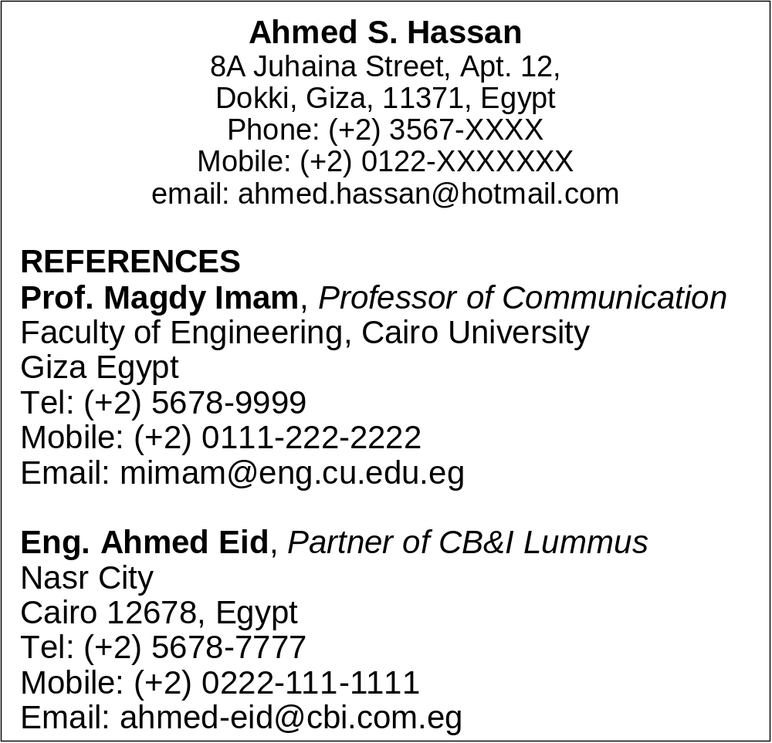
Main Sections of Resumé
References
- If references are required in the job ad, then include details in a separate sheet (name, position, company/university
name and location, telephone, mobile, email)
- References section should not be included with resume.
Notes:
Never use someone as a reference without their permission

Slide 19
Writing Tips for Resumé
- Keep resume to one page
- Write short phrases in a bullet format to quantify accomplishments
- Use plain and simple font (Times New Roman, size 11 or 12 pts)
- Use appropriate amount of white space
- List sections of your résumé in order of importance. In most cases,
“education” will be the first section for recent college graduates.
- Do not underline, as this interferes with many lower-case letters
- Do not include dates of attendance in your education section, just
dates of graduation (or expected date of graduation).
- Do not use pronouns such as “I”

Slide 20
Writing Tips for Resumé
- Be consistent in your format and use of bold, CAPS, italics, etc.
- CAPS. Use for section heads
- Bold. Use for section heads like EXPERIENCE and for your
name, institutions, and organizations you worked for
- Italics. Use for publications and titles of jobs or offices
Avoid using Microsoft Word and other software templates because your résumé may look too “cookie cutter.”
Pros: - Easy to get and use
- Gives an insight into the writing style
Cons: - All the same
- May not fit your own CV
- May give a bad impression

Slide 21
Sending Resumes By Business e-mail
- Write a proper subject line for your e-mail message
Subject: Resume of Ahmed Hassan
Subject: Response to Petroleum Engineer Job Opening
Subject: Seeking Summer Training Opportunity
- Include your resume and references, if any, as separate
attachments. Use the PDF format since it is best to prevent
formatting changes.
- Do not forget to introduce your attached resume and
references. (Use “attached” instead of “enclosed”)

Slide 22
Sending Resumes By Business e-mail
Strategy 1
- Include your cover letter as a separate attachment. (Colour
scan the signed version.)
- State that you have attached the cover letter with e-mail.
Strategy 2
- Write your cover letter as your e-mail message. Follow the
structure of cover letters, without the headings of letter and
the enclosure statement.
- Write concisely and limit your e-mail cover letter to about 20
lines to “fit the box”

Slide 23
More Writing Tips for Resumé:
Handling Weaknesses
I’m a new graduate and I won’t have an impressive CV
Highlight your academic record (resume)
Focus on your personal skills that might fit the position, e.g., meets deadlines (resume)
Emphasize that being young, you’re ready to work hard and under difficult conditions (cover letter)
Highlight that your young age is a plus as you can learn fast (cover letter)
Mention any plans for training courses, graduate studies, technical training (cover letter)

Slide 24
More Writing Tips for Resumé:
Handling Weaknesses
I don’t have the required skill or knowledge for a specific position
Highlight other skills that could bridge the gap (resume)
Offer to have training on the required skill (cover letter)
Enroll in courses or join online institutes to learn about the required skill (cover letter)

